Slide 1
Defense Thesis
CONTROLLING ROBOT USING PATH FOLLOWING AND KINECT
Thesis Advisor
<DR. Nguyen Tuan Nam>
Phan Hong-Duc 0712732
Do Hoang Tung 0712723

Slide 2
Content
1. Problem statement
2. Gesture recognition
3. Skeletal tracking
4. PID controler
5. Test cases and outcomes
6. Demos
7. Evaluation
8. Conclusion
9. Future work

Slide 3
Problem statement
Introduction
Thesis
Give orders to the robot through Kinect, by tracking and recognizing human gestures
The robot will keep following the line until it meets one of these conditions
The robot comes to a junction
There’s a “stop” command from human
The end of line

Slide 4
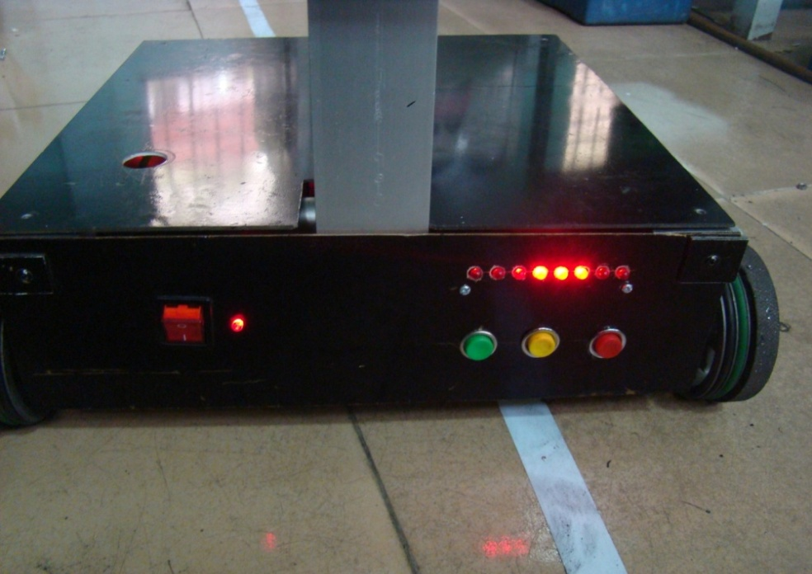
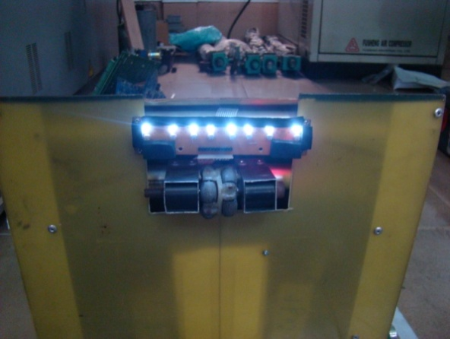
Problem statement
Path following robot

Slide 5
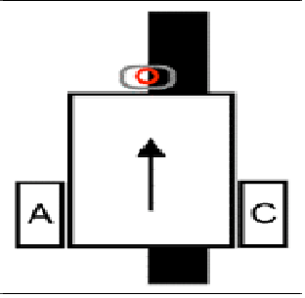
Problem statement
Basic layout of path following robot

Slide 6
Problem statement
Proposed methods
The robot takes command from human through Kinect
The definition of Gesture recognition is applied, especially skeletal tracking
The robot follow the line
Using PID controller

Slide 7
Gesture recognition
Definition:
A way for computer to understand human body language.
Interpreting human gestures via mathematical algorithms.
Application: Point a finger at the computer screen so that the cursor will move accordingly => can potentially replace some old input devices (mouse, keyboard, etc)
The ability to track a person's movements and determine what gestures they may be performing can be achieved through various tools. In this thesis, we use Kinect sensor, one of the depth-aware camera types.

Slide 8
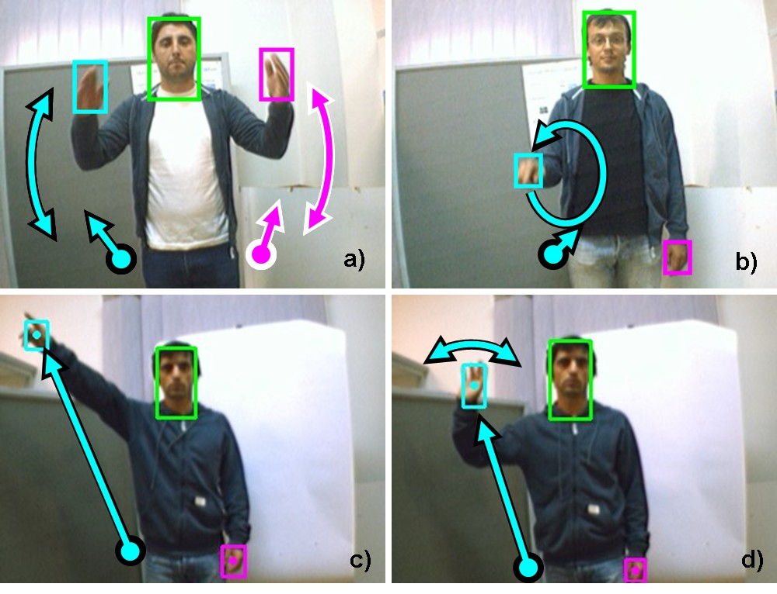
Gesture recognition
Taking pictures through human gestures

Slide 9
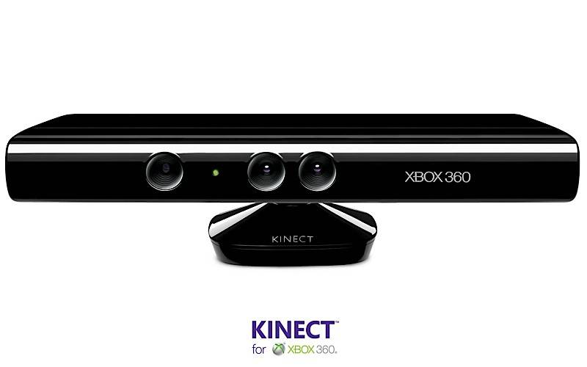
Gesture recognition
Kinect’s sensor

Slide 10
Gesture recognition
Library support
Laboratories Kinect Code.
Microsoft Kinect SDK beta.
Point cloud library.
OpenNI.

Slide 11
Gesture recognition
:
Algorithms
3D model based algorithms
Appearance based algorithms
Skeletal based algorithms

Slide 12
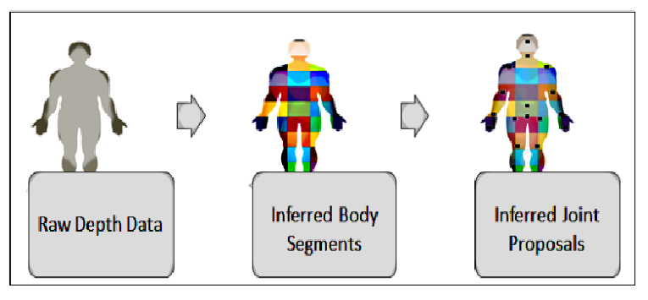
Skeletal tracking
How skeleton tracking works

Slide 13
Skeletal tracking
Step 1
Depth data is processed in the rendering pipelines process and generates inferred body segments.
Step 2
Identify all parts on the labeled data, then identify the body joints.
Step 3
Calculate the 3D view.
Step 4
Tracking human skeleton and body movement based on the proposed joint points and the 3D view.

Slide 14
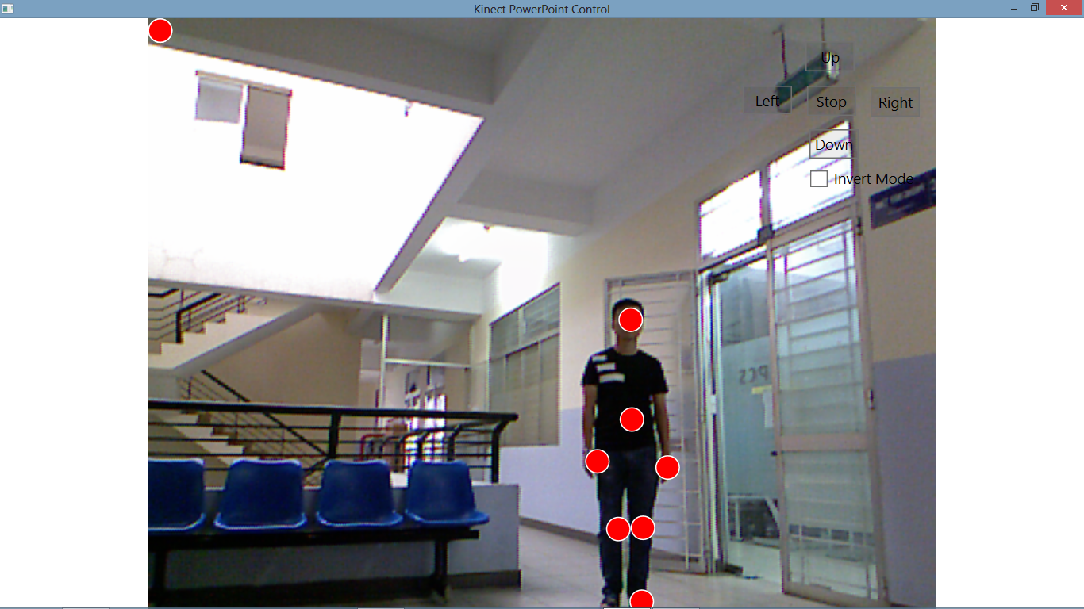
Skeletal tracking
Apply for controlling robot:
The initial state of the skeletal tracking:

Slide 15
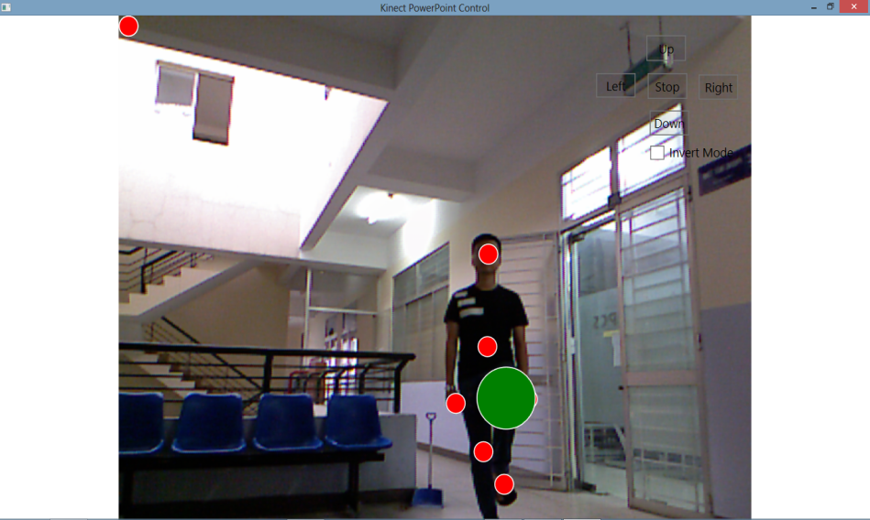
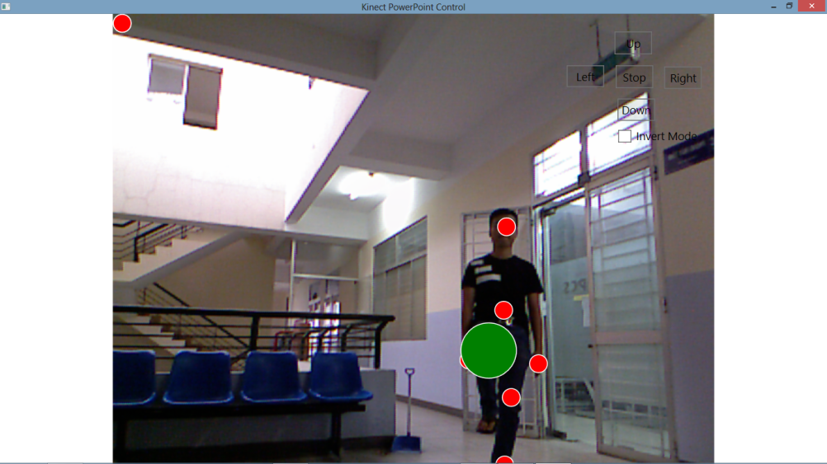
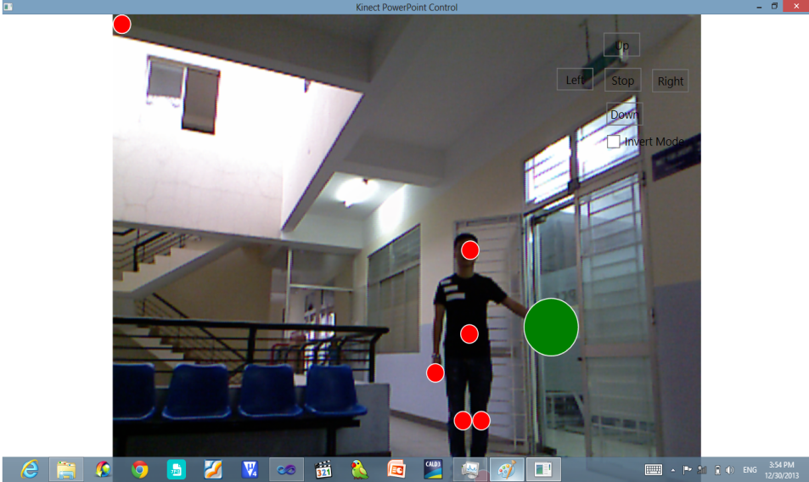
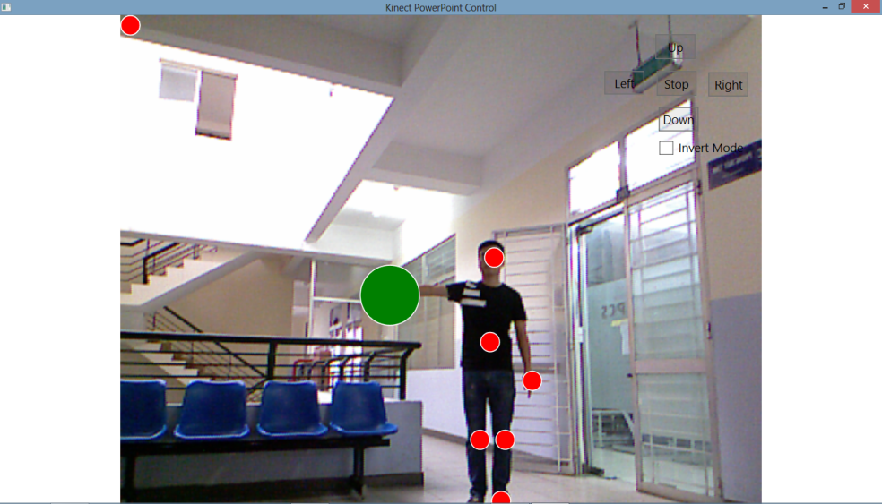
Skeletal tracking
Four basic commands:

Slide 16
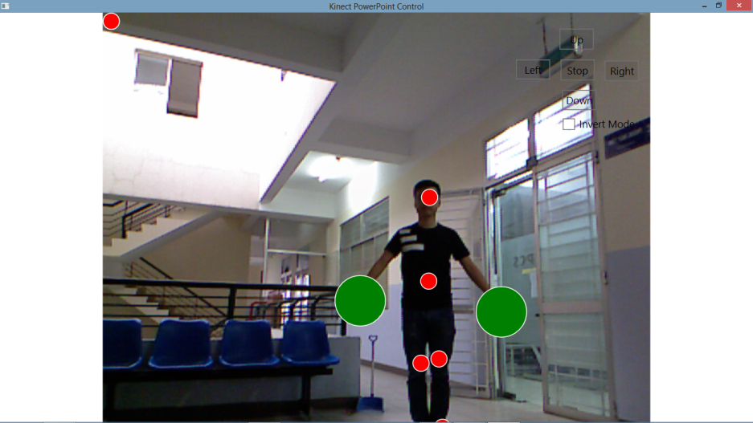
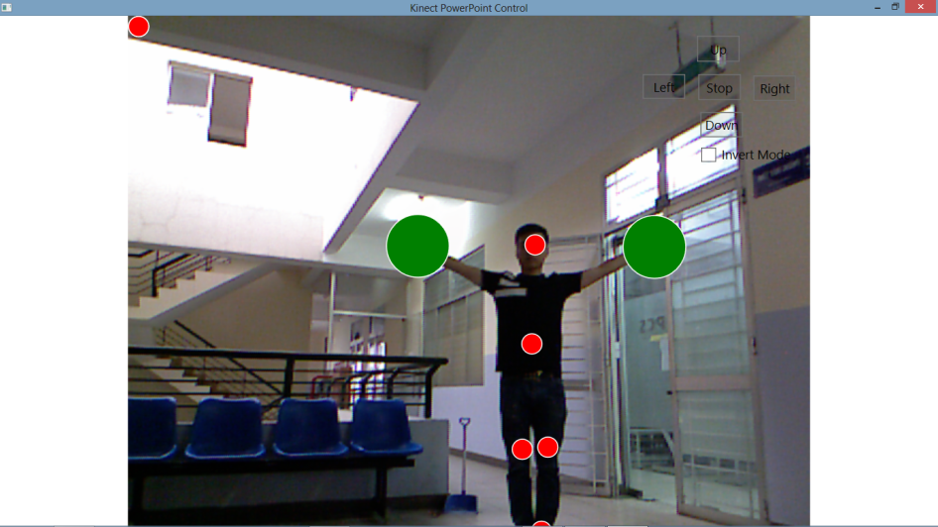
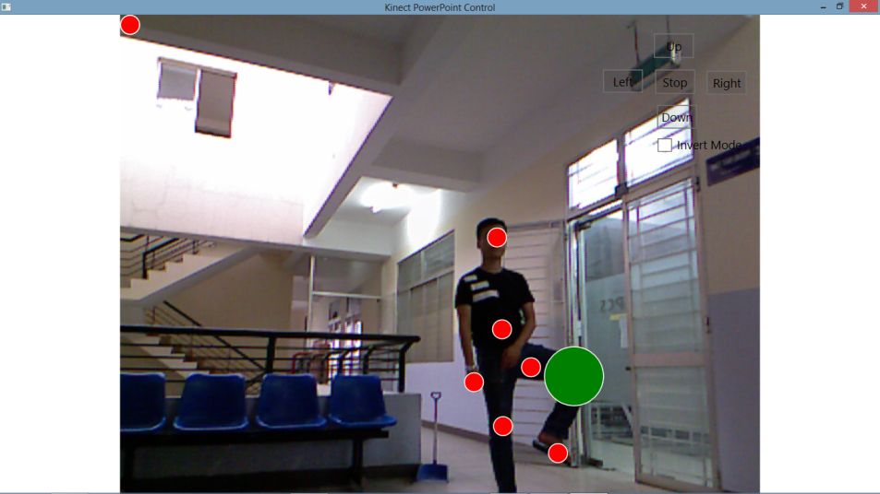
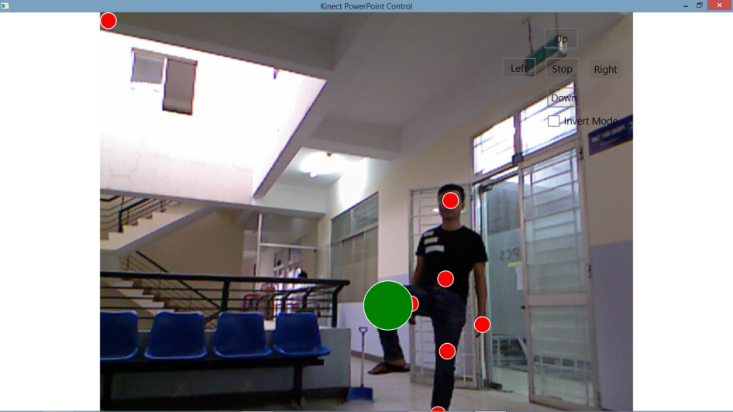
Skeletal tracking
The "range" of the commands

Slide 17
PID controller
What is the PID ?
P.I.D : Proportional Integral Derivative
Purpose of PID:
Wobbles when increase speed
Often found getting off track.
➔ More smoother, faster and efficient at greater speeds.
Notes:
PID is a common technique used to
control a wide variety of machinery including vehicles, robots and even
rockets. A PID controller calculates an "error" value as the difference between
a measured process variable and a desired setpoint. The controller attempts to
minimize the error by adjusting the process control inputs.

Slide 18
PID controller
PID controller
Implementation of PID:
PID fomulas:
Proportional:
Implementation of PID:
PID fomulas:
Proportional:
Error = (Target Position) - (Measured Position)
Proportional = Kp*(Error)
Notes:
The goal is to keep the robot in the middle of the road. Thus e will take about 0. KP is large, the force F is large, and the robot will quickly located mid-way, the acceleration a is large. when the robot was located mid-way, F= 0, but due to inertia, the robot will move left or right and robot is in out line . Process continues, the robot can not lie the line. This is overshot . we use D to brake to reduce the overshot. if D is large compared to P or P is small, the robot is approaching in mid-line position (not to the middle line), the robot can be stopped, even though e is not equal to 0. this is steady state error. To avoid steady state error, we add the controller function "cumulative" errors. When steady state error occurs, 2 component P and D had no effect, the new controller will be "cumulative" errors over time and increases the force F over time. At some point, the force F is large enough to overcome the overshot . adjust the robot is in the middle line.

Slide 19
PID controller
Implementation of PID:
PID fomulas:
Derivative :
Rate of Change = ((Difference) – (Previous Difference))/time interval
Derivative= Kd *(Rate of Change)

Slide 20
PID controller
Implementation of PID:
PID fomulas:
Integral:
Integral = Integral + Difference
Integral = Ki*(Integral)

Slide 21
PID controller
Control value used to adjust the robot’s motion =
(Proportional) + (Integral) + (Derivative)

Slide 22
PID controller
Tuning:
Set Kp, Ki, Kd = 0
Set Kp = 1, then observe:
Overshoot and lose the line : reduce Kp
Sluggish : increase Kp
Set Kd = 1 : increase Kd until the wobbling is less.
Set Ki = (0.5,1) adjust the value by 0.01 increment.

Slide 23
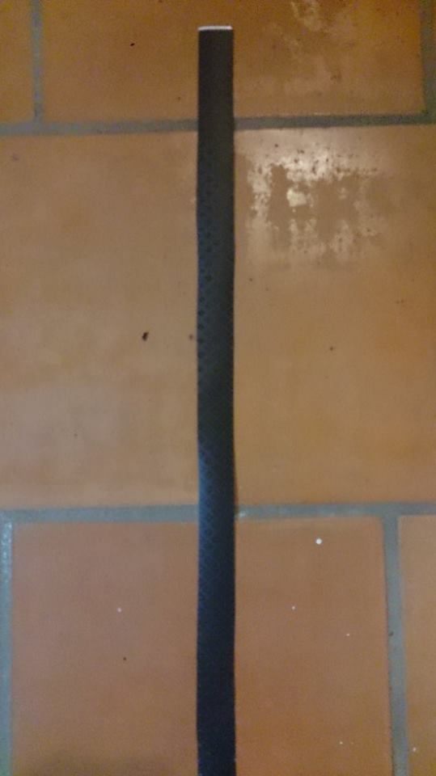
Test cases and outcomes
Case 1 : The line’s color is “closed” to the color of the environment
Outcome: the robot can follow the line, but not stable. Sometimes, it stop in the middle of the race, and can't move on even we order it to go.

Slide 24
Test cases and outcomes
Case 2: only a straight line, no junction
Outcome: the robot stops at the end of line

Slide 25
Test cases and outcomes
Case 3: Command the robot to go straight/turn left/ turn right when there’s no line
Outcome : the robot does not go straight, but it does turn left and right.
=> Solution: The robot will stop after 15 seconds if it does not detect any new line

Slide 26
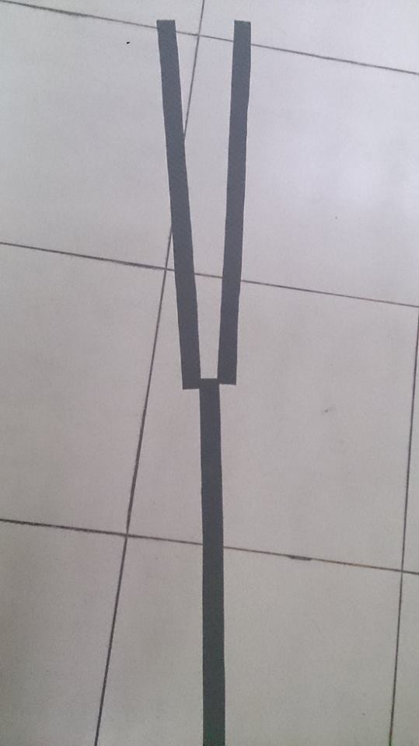
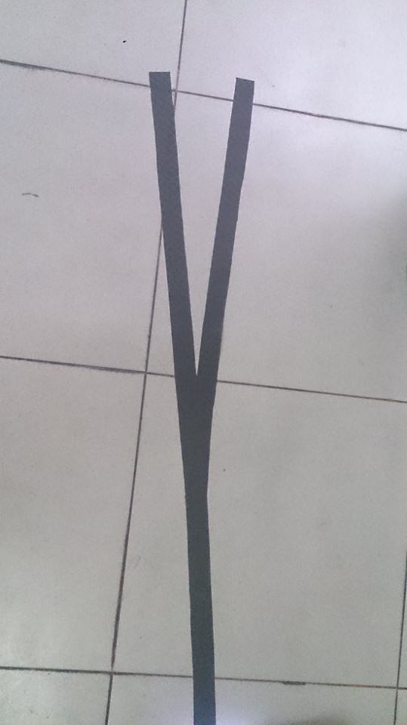
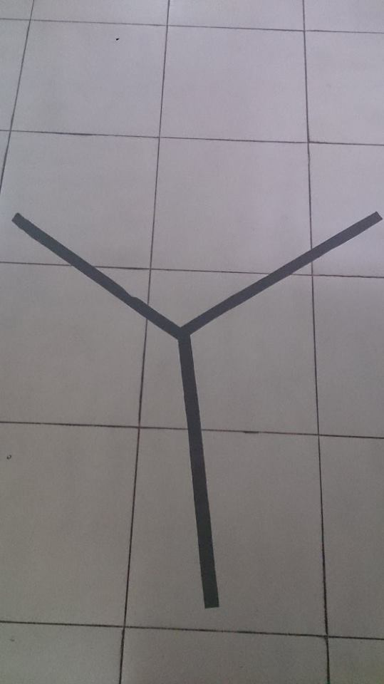
Test cases and outcomes
Case 4: Y-shaped juntions
Outcome: the robot can stop at the junction in 3 cases. However, in picture 1 and 2, the robot go out of line when turn left or right

Slide 27
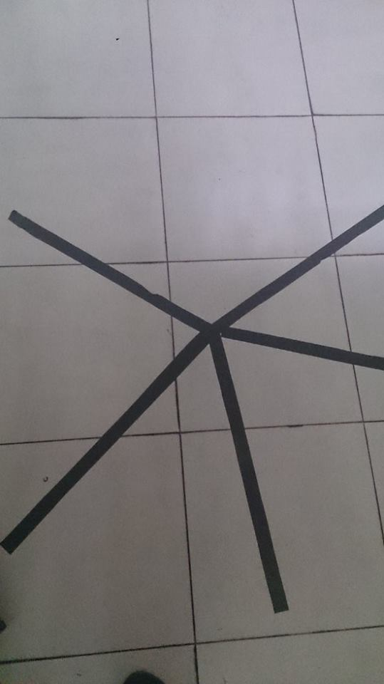
Test cases and outcomes
Case 5: the roundabout
Outcome: It is similar to the y-shaped junction, can stop at the cross point

Slide 28
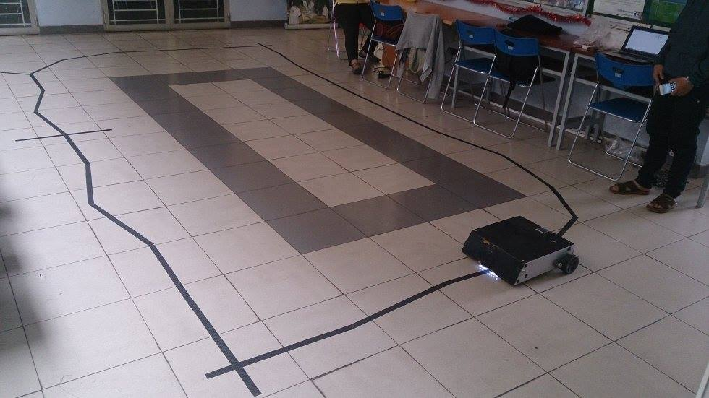
Test cases and outcomes
Case 6: Mixed case: we mix up some previous cases to build a race like the following picture

Slide 29
Demo

Slide 30
Demo

Slide 31
Demo

Slide 32
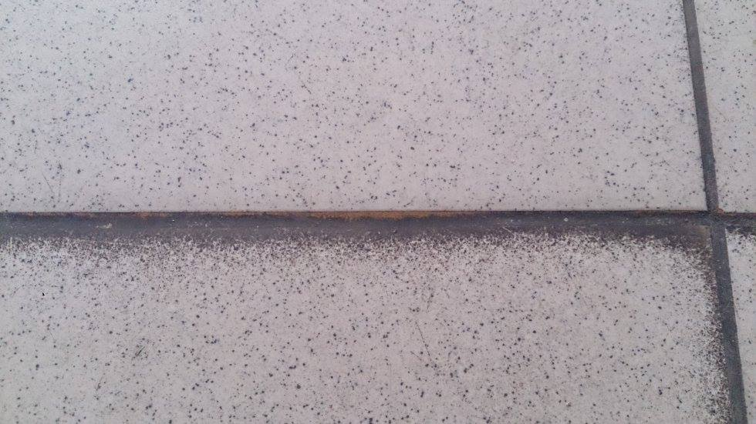
Evaluation
We have figured some problems:
The robot sometimes stops in the middle of the road because of some dirt between the bricks
The robot keep turning left/right until it runs out of battery of turns off power

Slide 33
Evaluation
Beside those bugs:
The robot is running stable in most the demos.
The robot can detect wide range of junctions.
Greatly reduced wobbles when changing directions.

Slide 34
Conclusion
Studied 2 technologies for controlling robots: path following and using Kinect. Understand their features, algorithm and application
Not an easy road: wasting too much time at the beginning researching about avoiding ostacles using Kinect.
Take an inspiration from controlling power point slides through Kinect, then combine with path following robot to become the hybrid approach.

Slide 35
Future works
Face recognition and speed recognition: Kinect can train the voice and face of a certain user, remember him/her and only take commands from him/her.
The robot go from point A to point B automatically
Continue developing the idea of using Kinect to avoid ostacles.

Slide 36
Thank you for listenning

